Slide 1
COMPLAINT MANAGEMENT SYSYTEM FOR ISP
By
Nandakishor
I10MCA

Slide 2
INTRODUCTION
The main idea is to implement a complaint system for customers for raising complaints on the issues related to ISP provider and provide best customer care service for users using this website. There are many Internet Service providers that will provide internet services for users on different packages. Basically, ISP works on three connections, Dial Up using telephone service, Broad band and wireless connections. In any case there arises a lot of problems related to the services that an ISP provides on a daily basis. The poor handling of this problems are mainly due to unorganized practices that are being followed over these years. Now with the amount of broadband and wi-fi connections getting increased day by day as people are working from home and education via online classes and courses are gaining more momentum, it is important that these issues are to be addressed faster and more efficiently for the obtaining customer satisfaction.

Slide 3
Existing system
The current system works completely in an unorganized manner where the user has to call the customer service or the local operator to provide with a solution for their problems.
This method has been inadequate for so long that people are not getting the service quality they expect from the customer service of the ISP clients. It can be due to either improper handling of the case or other human errors such as ignorance of the local operators, lack of work ethics, laziness etc.
Thus the current unorganized functioning of the service functionality of the ISP client needs to be removed by introducing a new and properly organized system where the users can actually monitor and validate their complaint handling by the ISP client.

Slide 4
PROBLEM DEFENITION
An effective complaints management system is integral to providing quality customer service. It helps to measure customer satisfaction and is a useful source of information and feedback for improving services. Often customers are the first to identify when things are not working properly.
Thus for tackling the problem we intend to generalize the service department and make it more accessible and transparent for the customers so that the customers actually have some control over the whole process.
The scope of the system is quite wide. It can be implemented on a WAP-enabled mobile handset, thus providing the Customers and the Providers, the ease of accessing the projects and their status without any difficulty and within no time.

Slide 5
Proposed system
The ultimate aim is to create a online portal that can be generally used by both the users and the administrators or the customer service department of the ISP client.
The user can register their complaints in a precise and detailed manner via the portal
The admin can view and manage the incoming complaints. Admin can open a complaint and assign it to appropriate local operators/sub-admins. Admin also has the total control of the portal from editing, managing, assigning, monitoring, creating etc of everything present in the portal.
The sub-admins get assigned with the tasks and can proceed to act up on those assigned tasks. Each sub admins will be assigned with their own tasks so that there is no confusion among themselves on which all tasks they are assigned with. Also the work can be evenly distributed to every sub-admins by the Admin and thereby maintaining the workload evenly between them.

Slide 6
Objective of the project
Identification of the drawbacks of the existing system leads to the designing of computerized system that will be the one that will be more user friendly and more GUI oriented. We can improve the efficiency of the system, thus overcome the drawbacks of the existing system.
The project tries to accomplish all the following features:
1) Smooth flow of data without any hurdles.
2) Facility to update data from time to time.
3) Prompt and specific retrieval of data.
4) Accuracy, timeliness and comprehensiveness of the system output.
5) Stability and operability by people of average intelligence.
6) Enhancement in the completion of work within the constraints of time

Slide 7
MODULES

Slide 8
1) ADMIN PANEL
1. Admin Login : Admin can login through login form.
2. Dashboard : In this section, admin can see all detail in brief like the total complaints, in process complaints and closed complaints. Admin can also view sub admin complaints status.
3. Category : Admin can manage categories (Add, update, delete)
4. Sub Category : Admin can manage Subcategories (Add, update, delete)
5. Sub-admin : Admin can manage sub-admins (Add, Update)
6. Manage Complaints : Access Complaint info, Change Complaint status and also forwarded complaints to the sub-admins.
7. Manage the Users : Admin can manage the all the Users Profile. Take a print out of all profiles.
8. Reports : In this section, admin can generate two types of report. One is b/w dates report and another is sub admin report b/w dates reports.
9. Users log : Admin can also view user log info
10. Profile : Admin can update their own profile.

Slide 9
2) SUB-ADMINS
1. Sub-Admin Login : Sub-Admin can login through login form.
2. Dashboard : In this section, Sub admin can see all detail in brief like the total complaints, in process complaints and closed complaints assign to him
3. Manage Complaints : In this section, sub admin can access the complaint details and change the status of the complaints
4. Profile : In this section sub-admin can update own profile.

Slide 10
3) USER PANEL
1.User registration/Log in : User can register/login through the form
2. User profile : User can manage own profile
3.Complaint lobby : User can Lodge his/her Complaint.
4. Complaint history: Users can view lodged complaints and status.

Slide 11
SYSTEM ENVIRONMENT
HARDWARE CONFIGURATION (min)
1. Pentium IV Processor
2. 512 MB RAM
3. 10GB HDD
1024 * 768 Resolution Colour Monitor
SOFTWARE CONFIGUARION (min)
1. OS : Windows XP
2.PHP Triad (PHP5.6, MySQL, Apache, and PhpMyAdmin)

Slide 12
UML DIAGRAMS

Slide 13
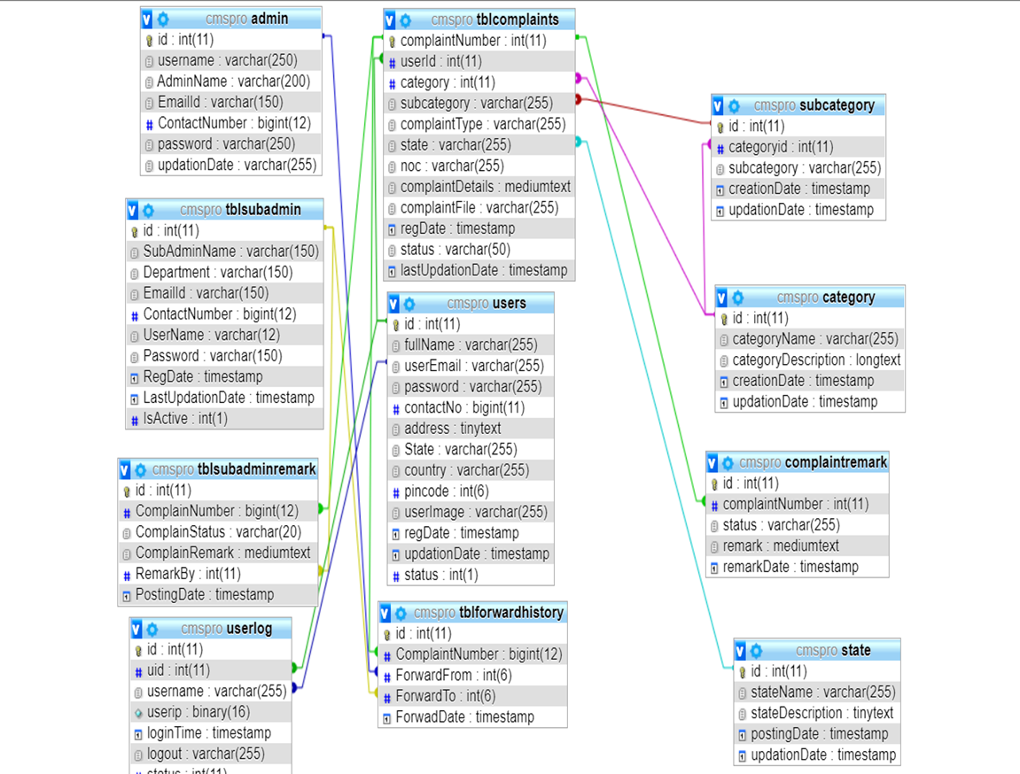
CLASS DIAGRAM

Slide 14
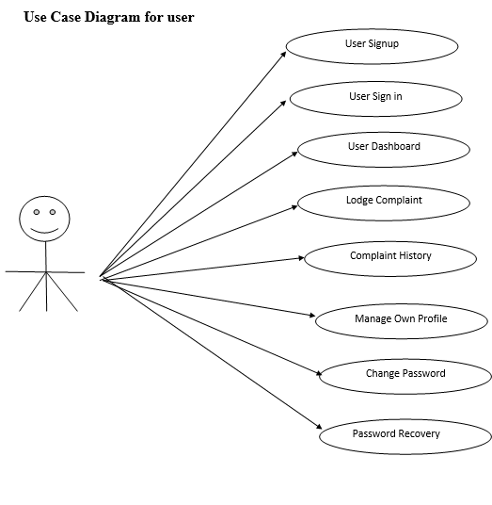
Use case diagrams

Slide 15
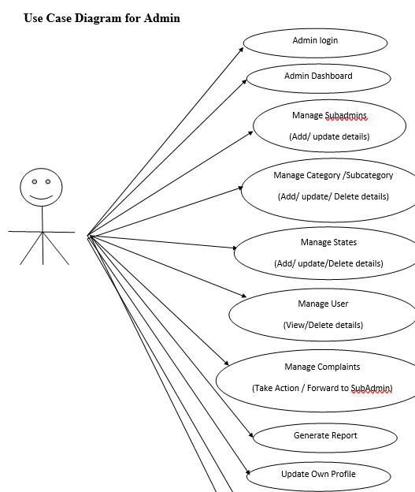
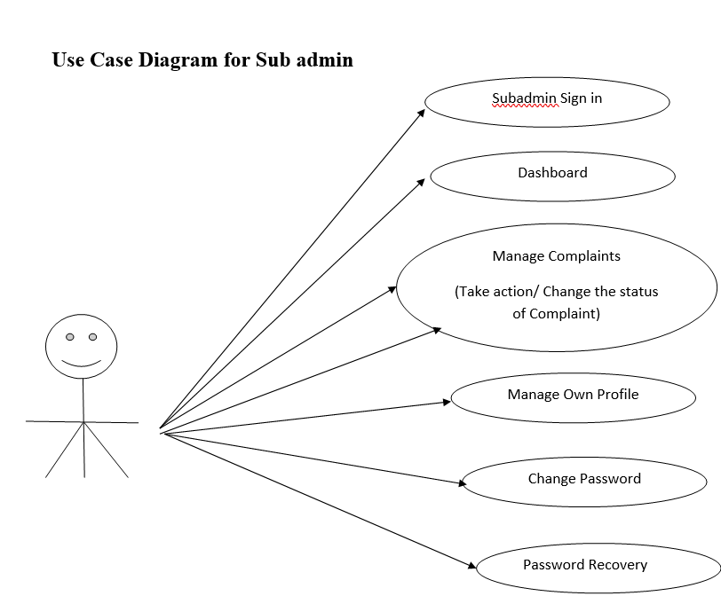

Slide 16
USER STORIES
USER TYPE | EPIC | USER STORIES
ADMIN | Login | As an admin I can login/register to an application by entering user id and password
 | Dashboard | As and admin I can view and manage the user complaints and transfer them to the appropriate sub-admins for taking actions.
USER | Login | As a user I can login/register to the portal and register my complaint with description
 | My Account | As a use I can view my personal information, update them and monitor my complaint status
SUB-ADMIN | Login | As a sub-admin I can login from the portal by entering the login credentials
 | Dashboard | As a sub-admin I am able to view my day-to-day assigned tasks and update the status of them

Slide 17
Database design

Slide 18
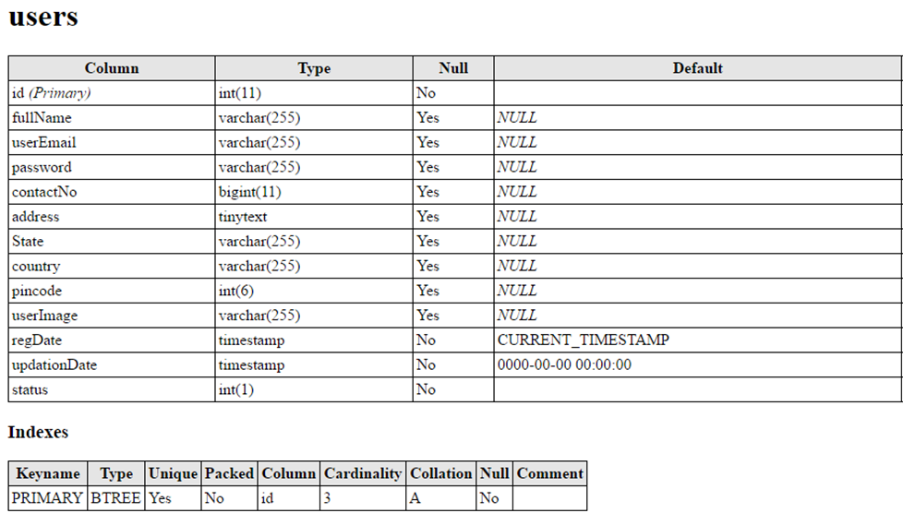
Users Table: This table stores user personal and login details.

Slide 19
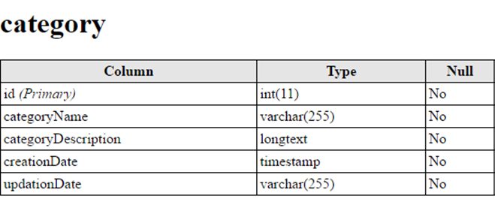
Category Table: This table stores category details.

Slide 20
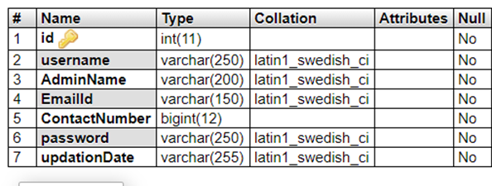
Admin Table: This tables store admin login details.

Slide 21
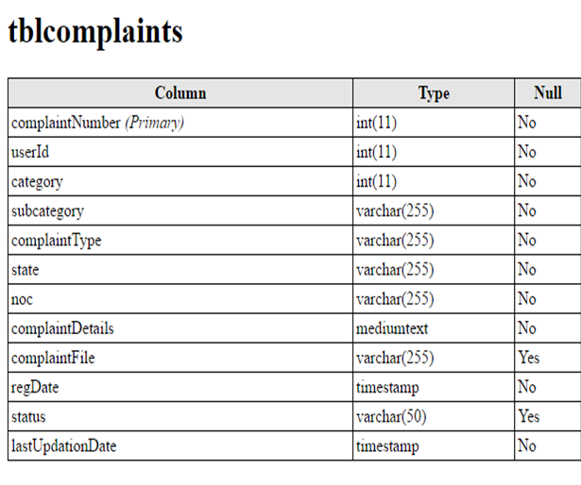
Tbl complaints Table : This table store user complaint details.

Slide 22
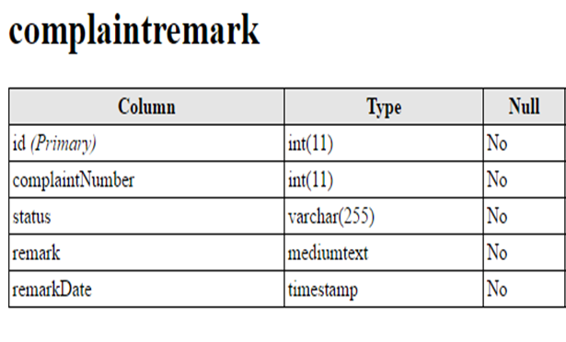
Complaint remark Table: This Table stores admin complaint remarks.

Slide 23
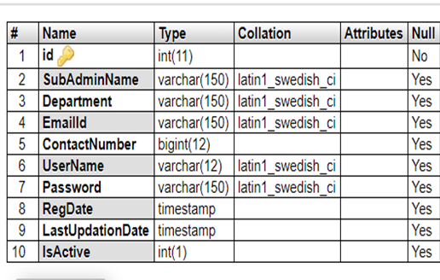
Tbl subadmin Table: This table stores subadmin personal and login details.

Slide 24
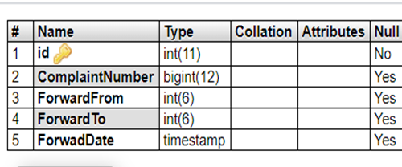
Tbl forward history Table : This table stores complaint forward history

Slide 25
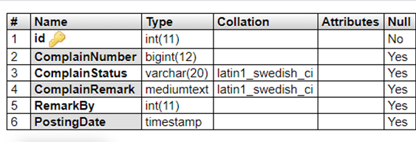
Tbl sub admin remark Table : This table stores sub admin complaint remarks

Slide 26
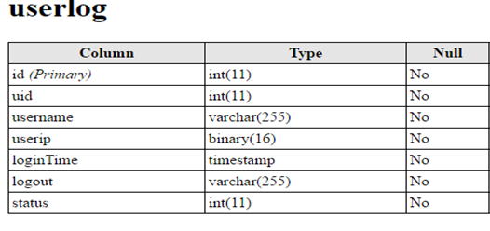
User log Table : This table stores users login details.

Slide 27
SCREENSHOTS

Slide 28
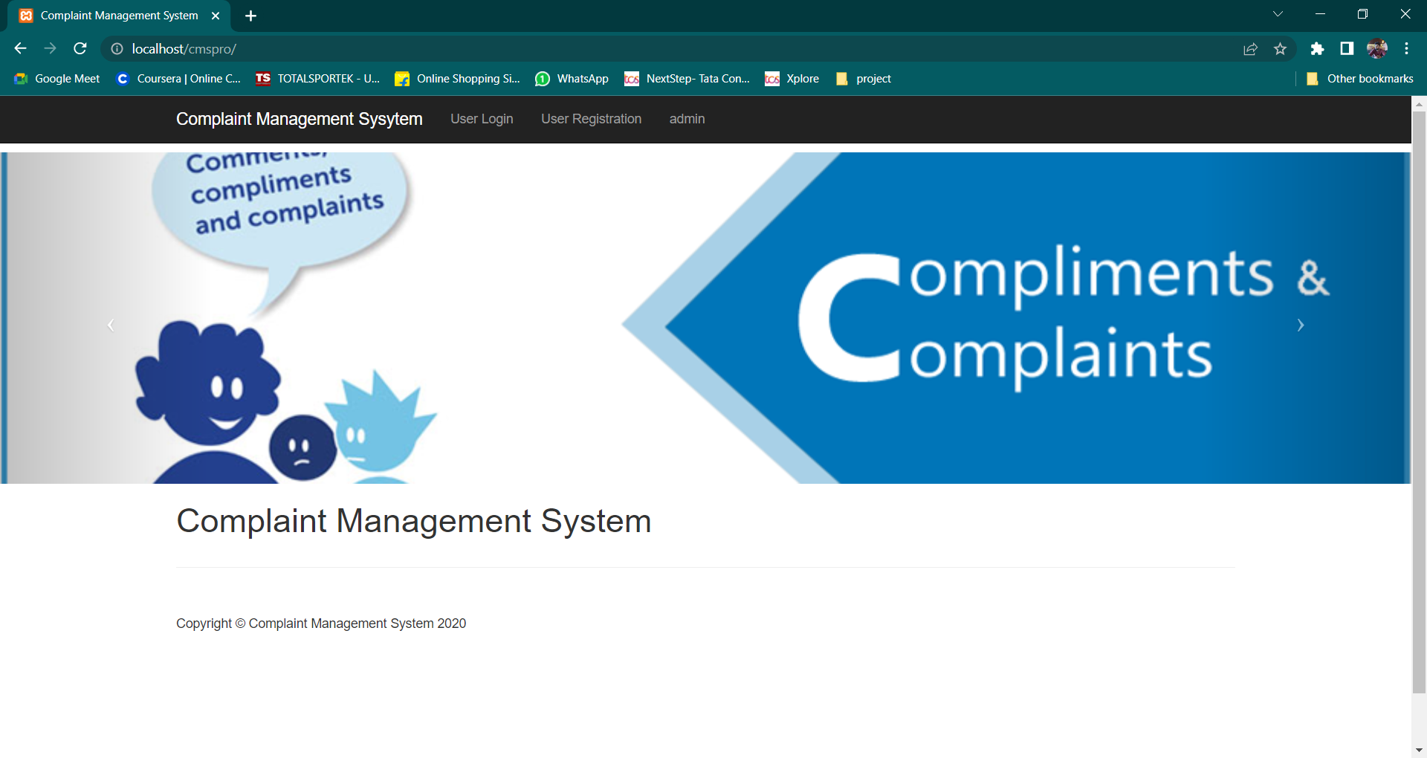

Slide 29
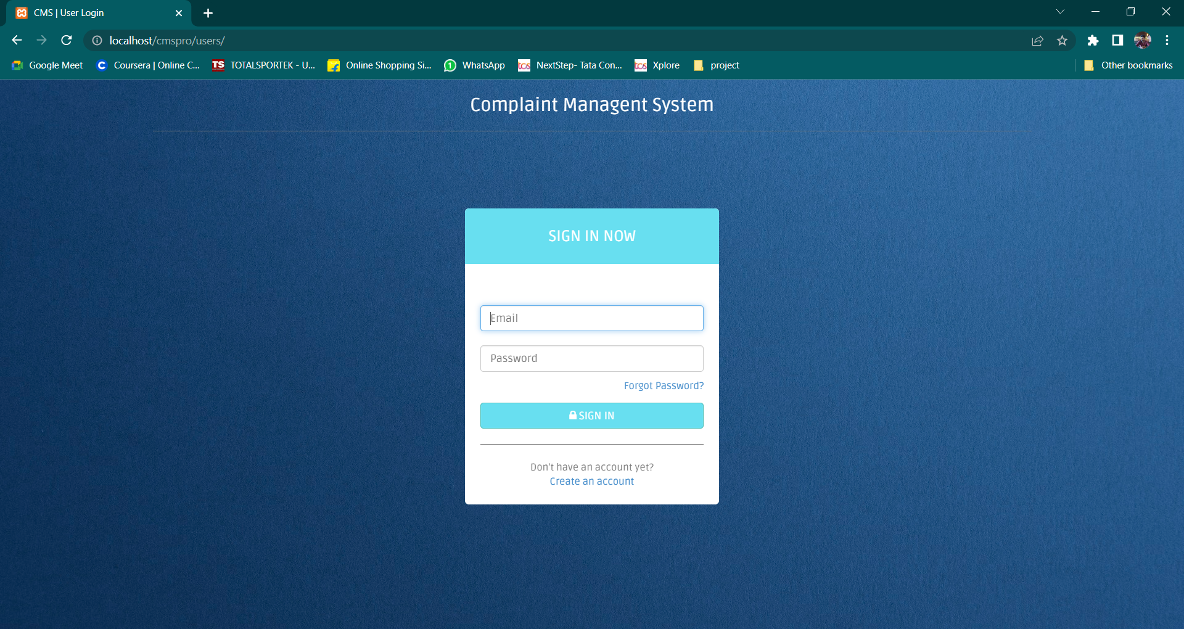

Slide 30
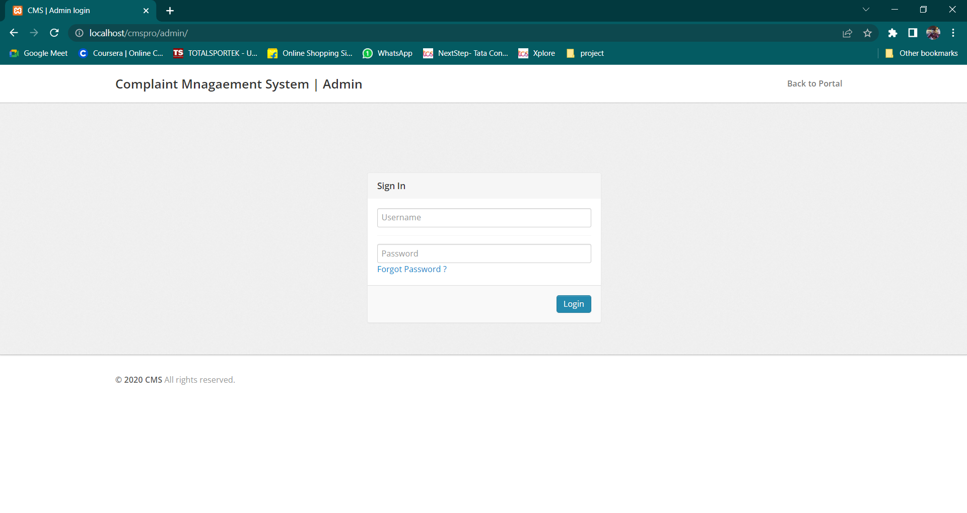

Slide 31
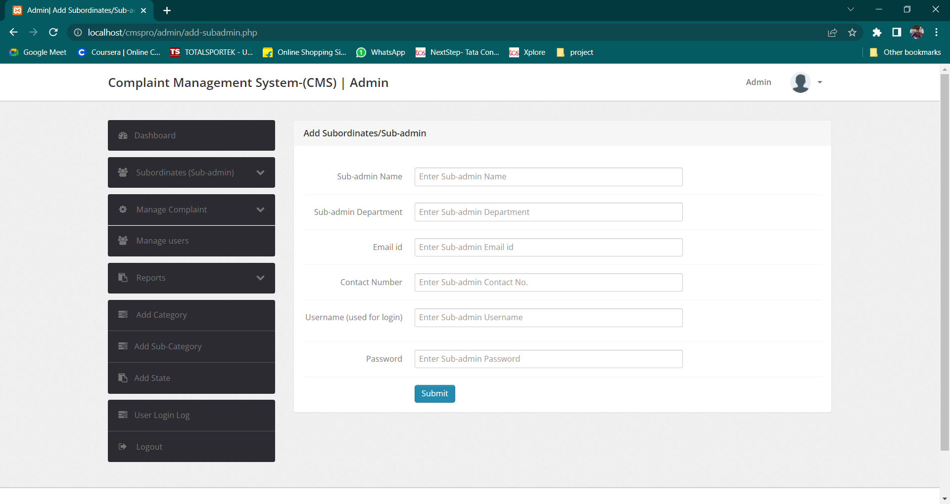
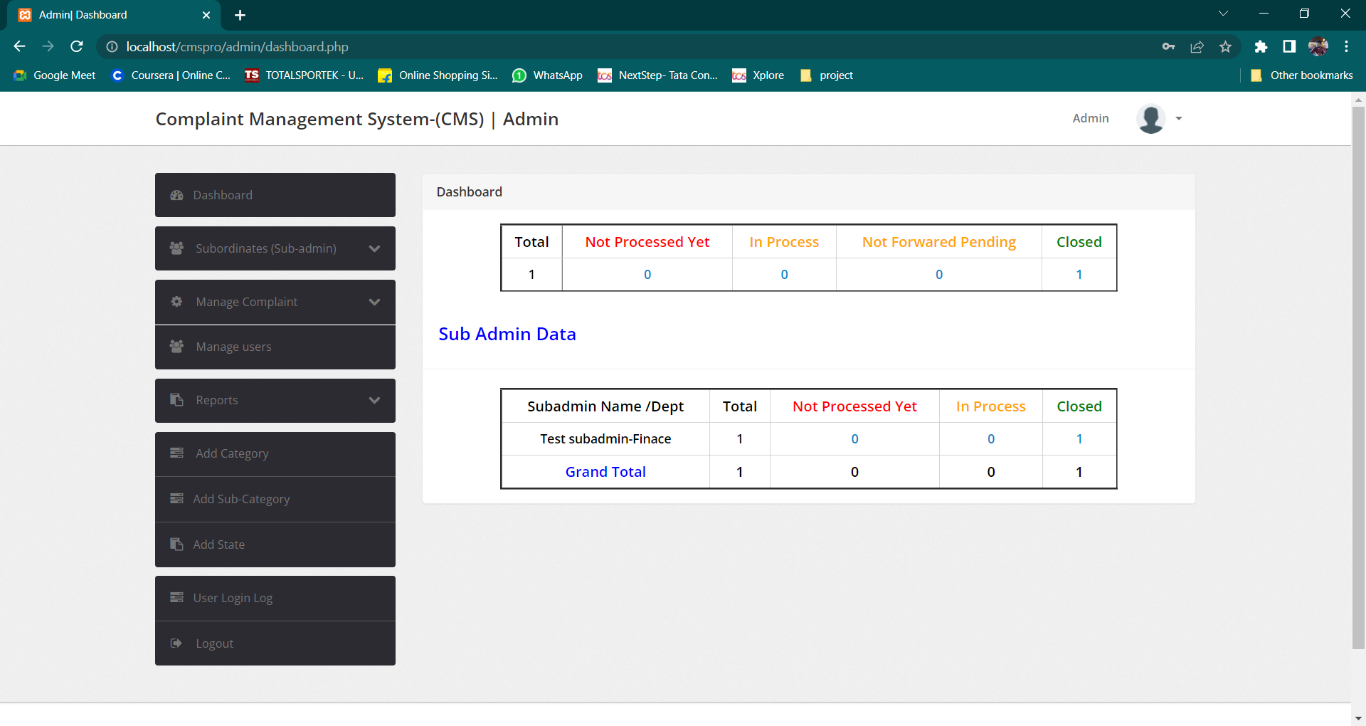

Slide 32
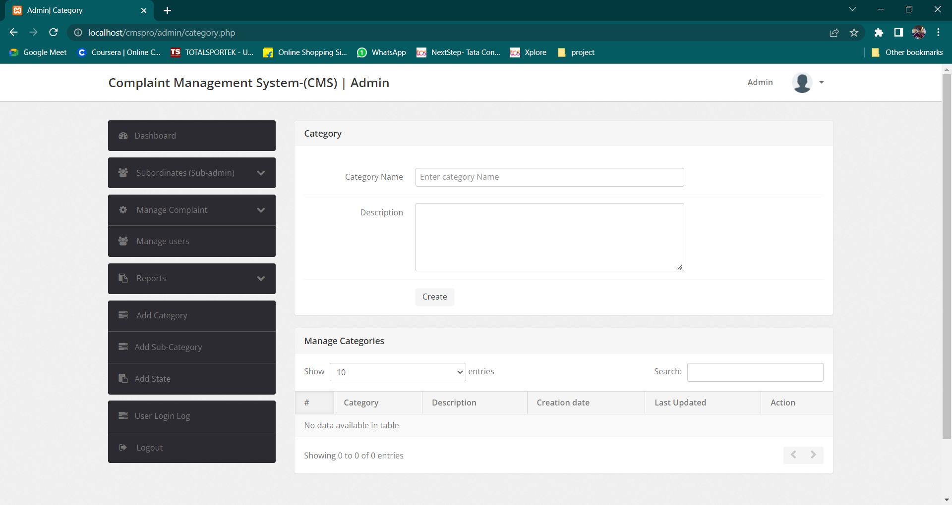
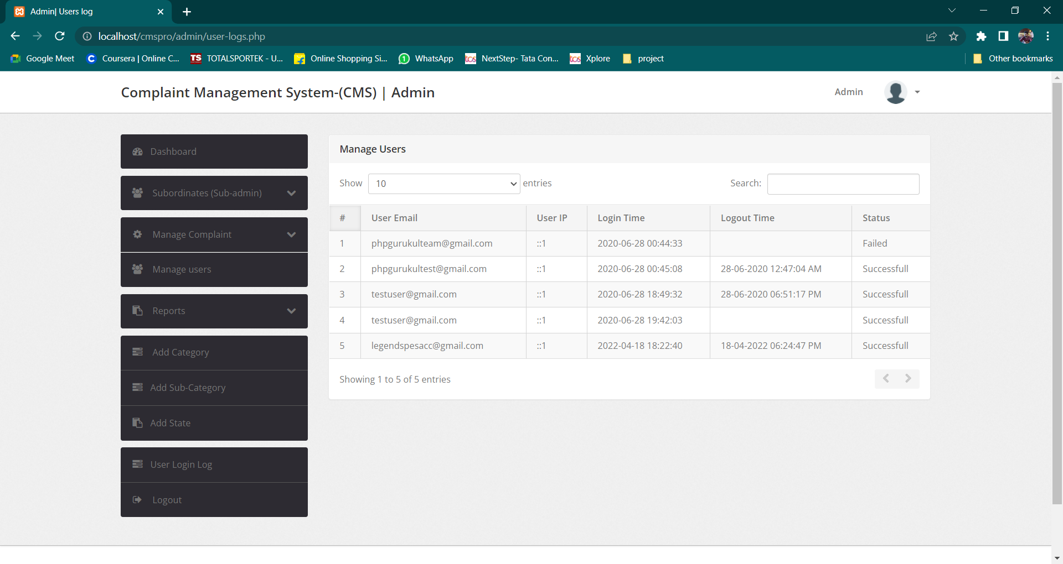

Slide 33
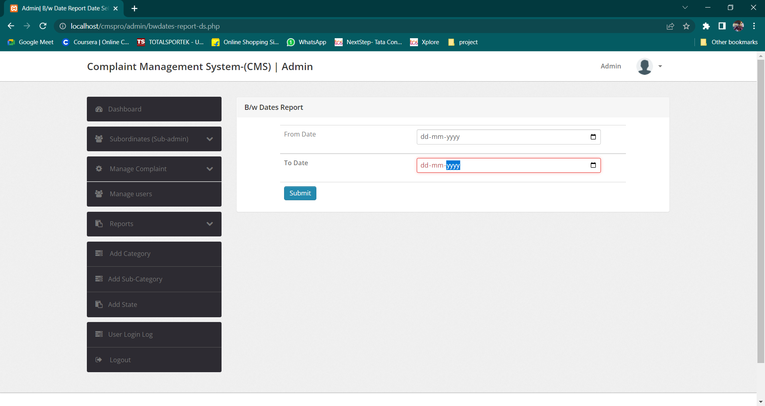

Slide 34
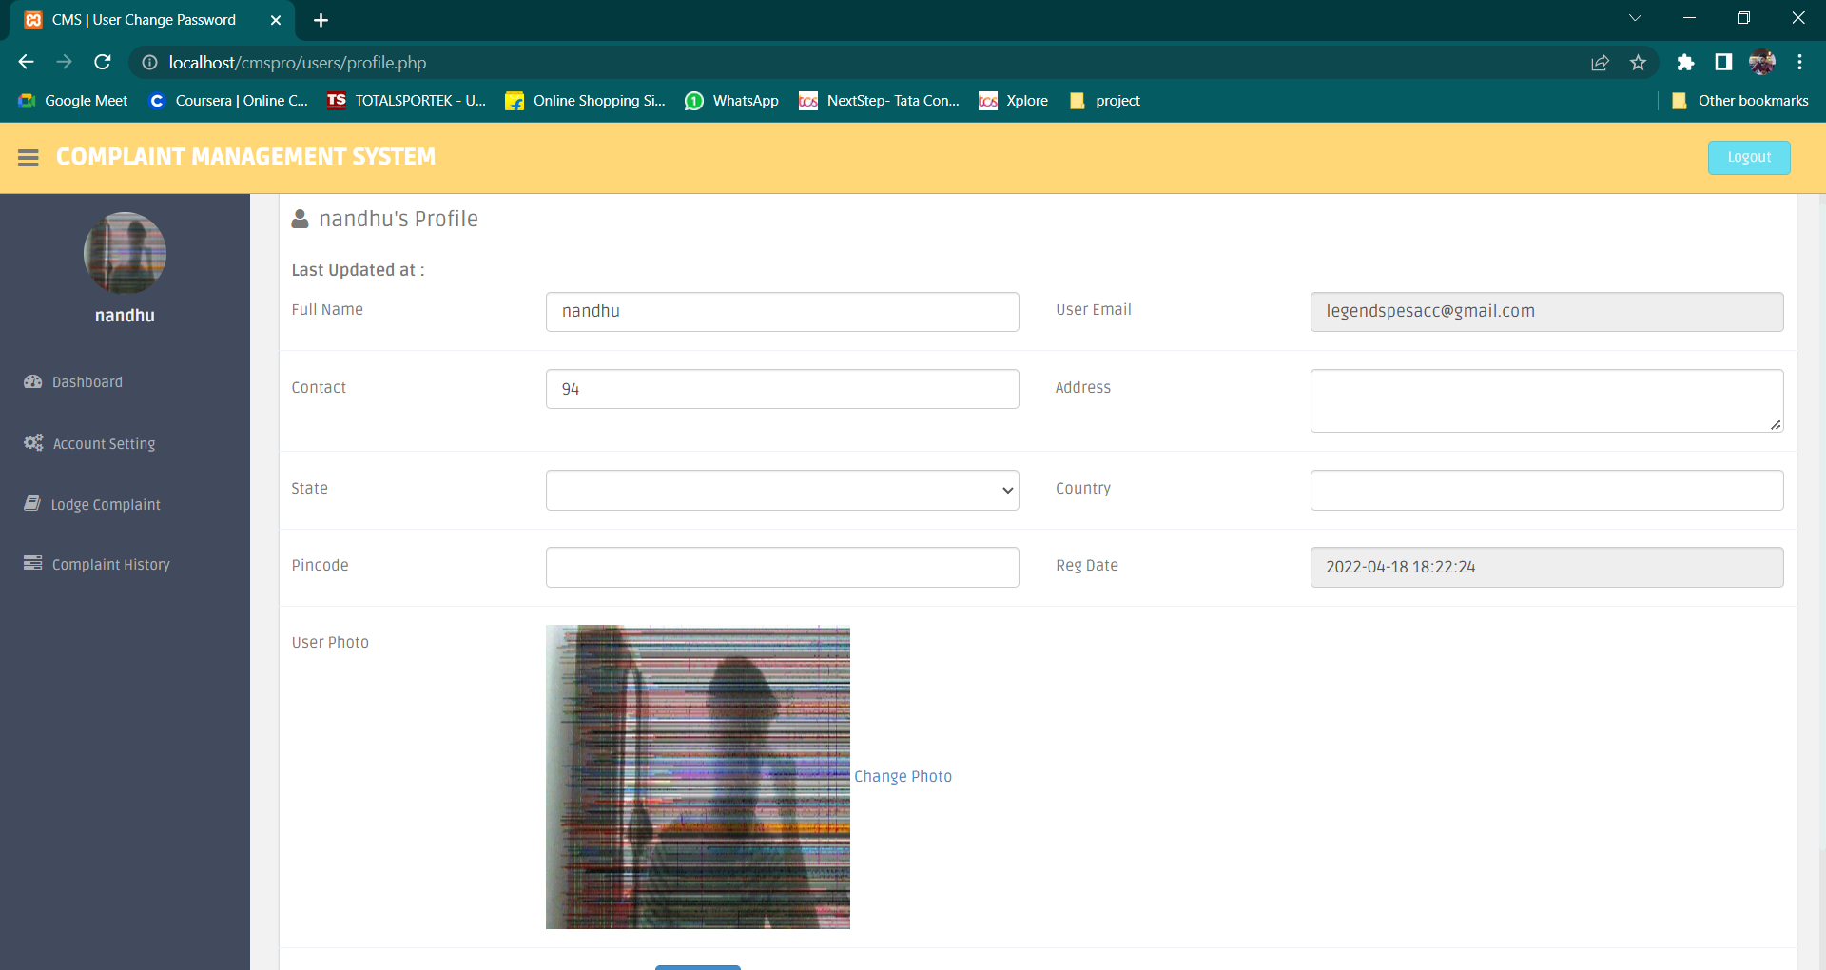
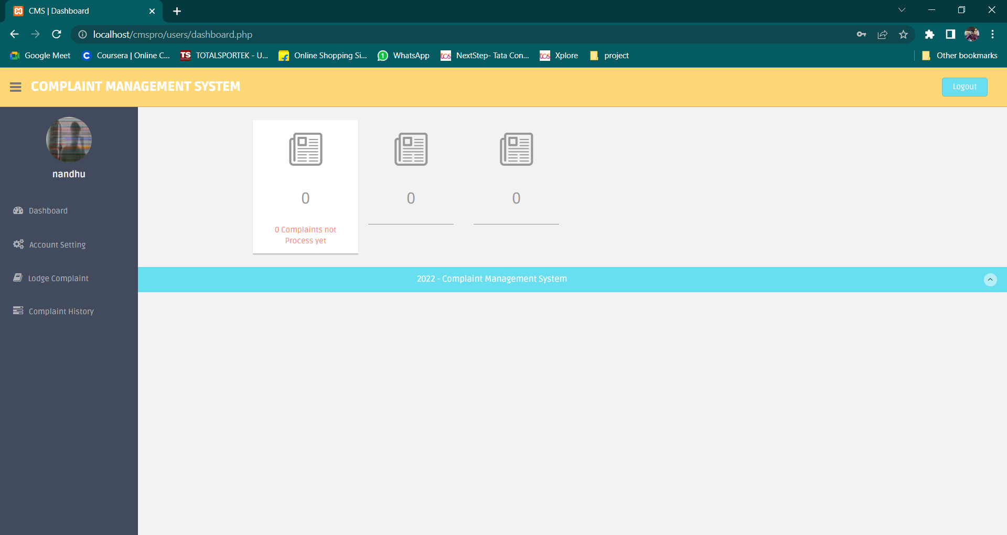

Slide 35
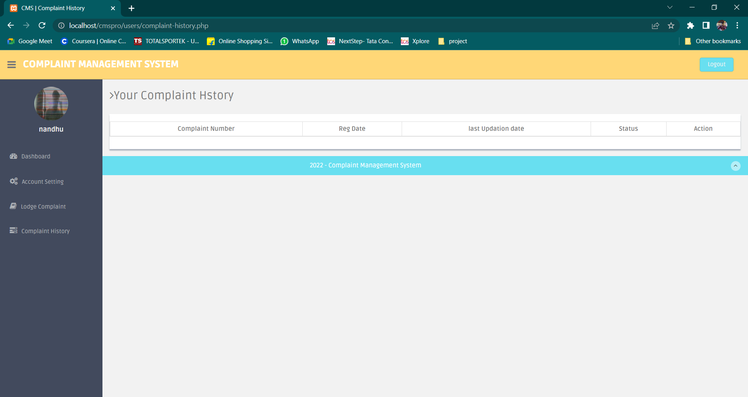
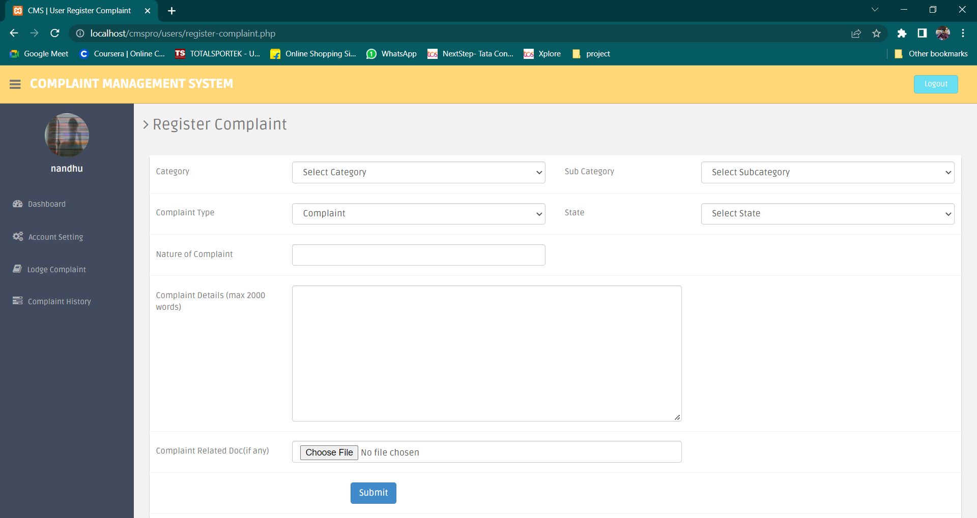

Slide 36
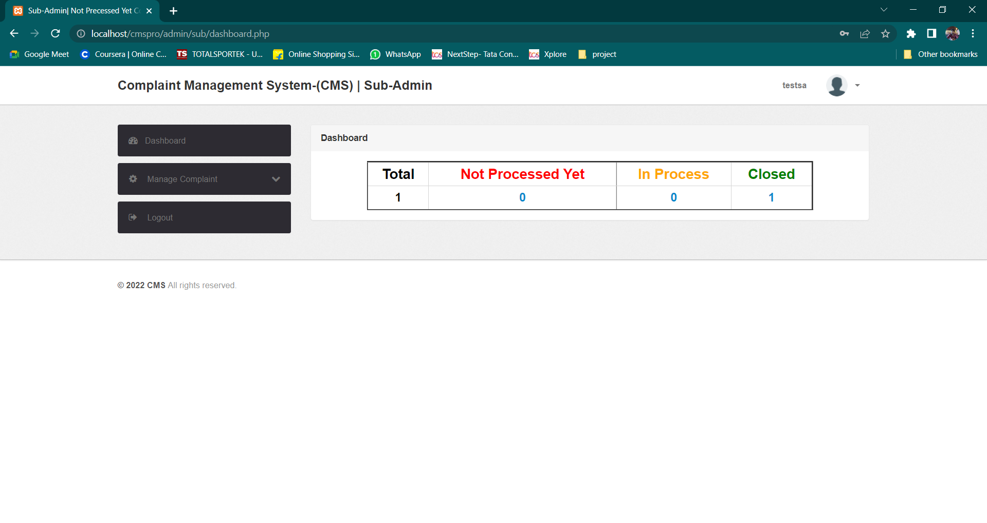

Slide 37
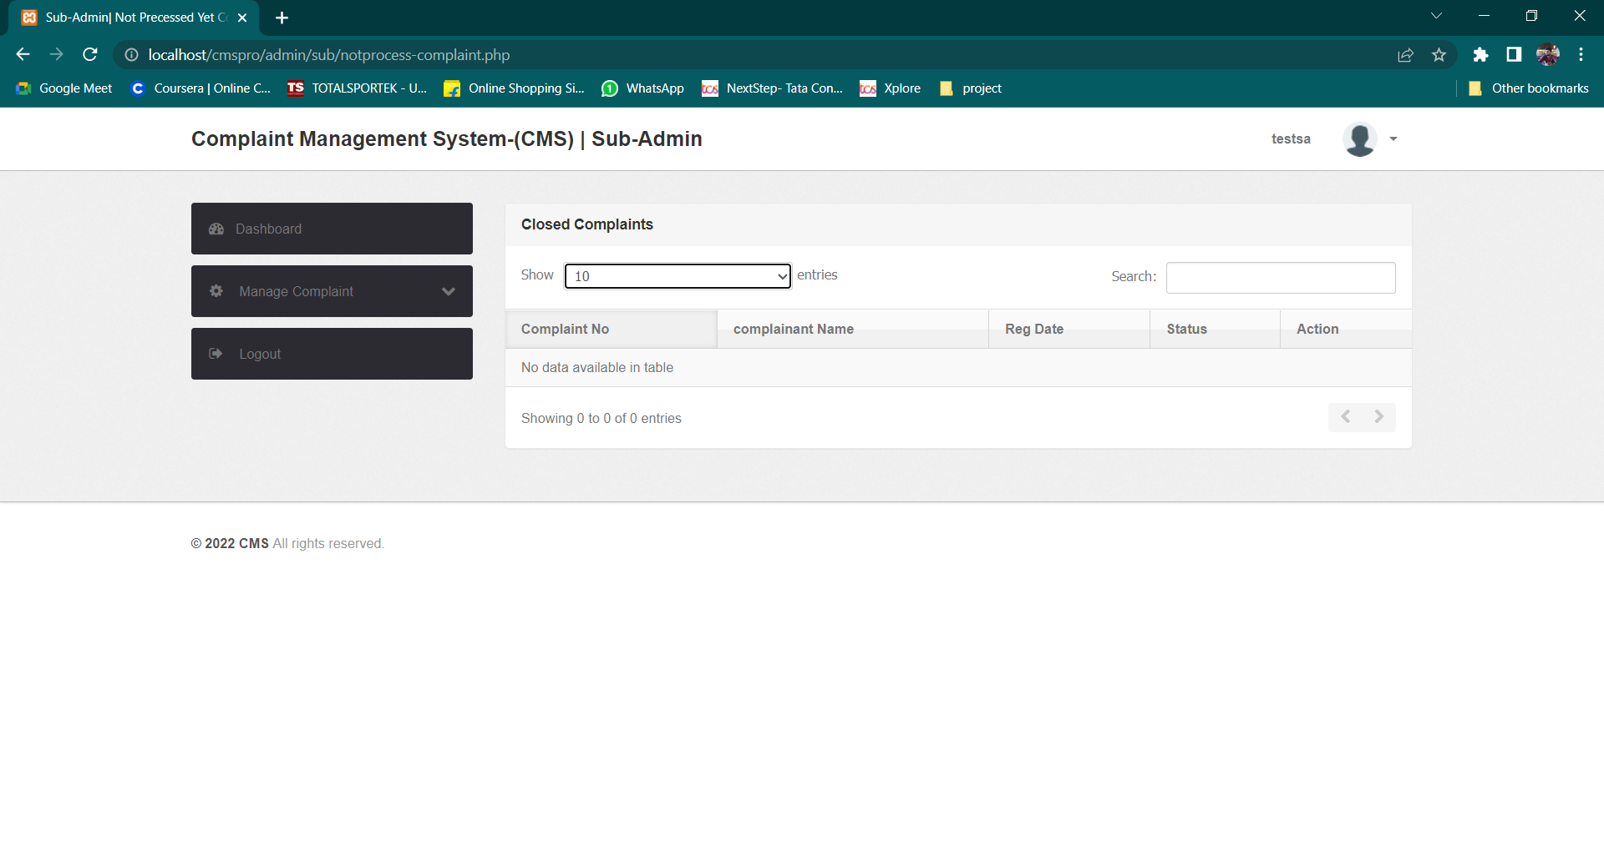

Slide 38
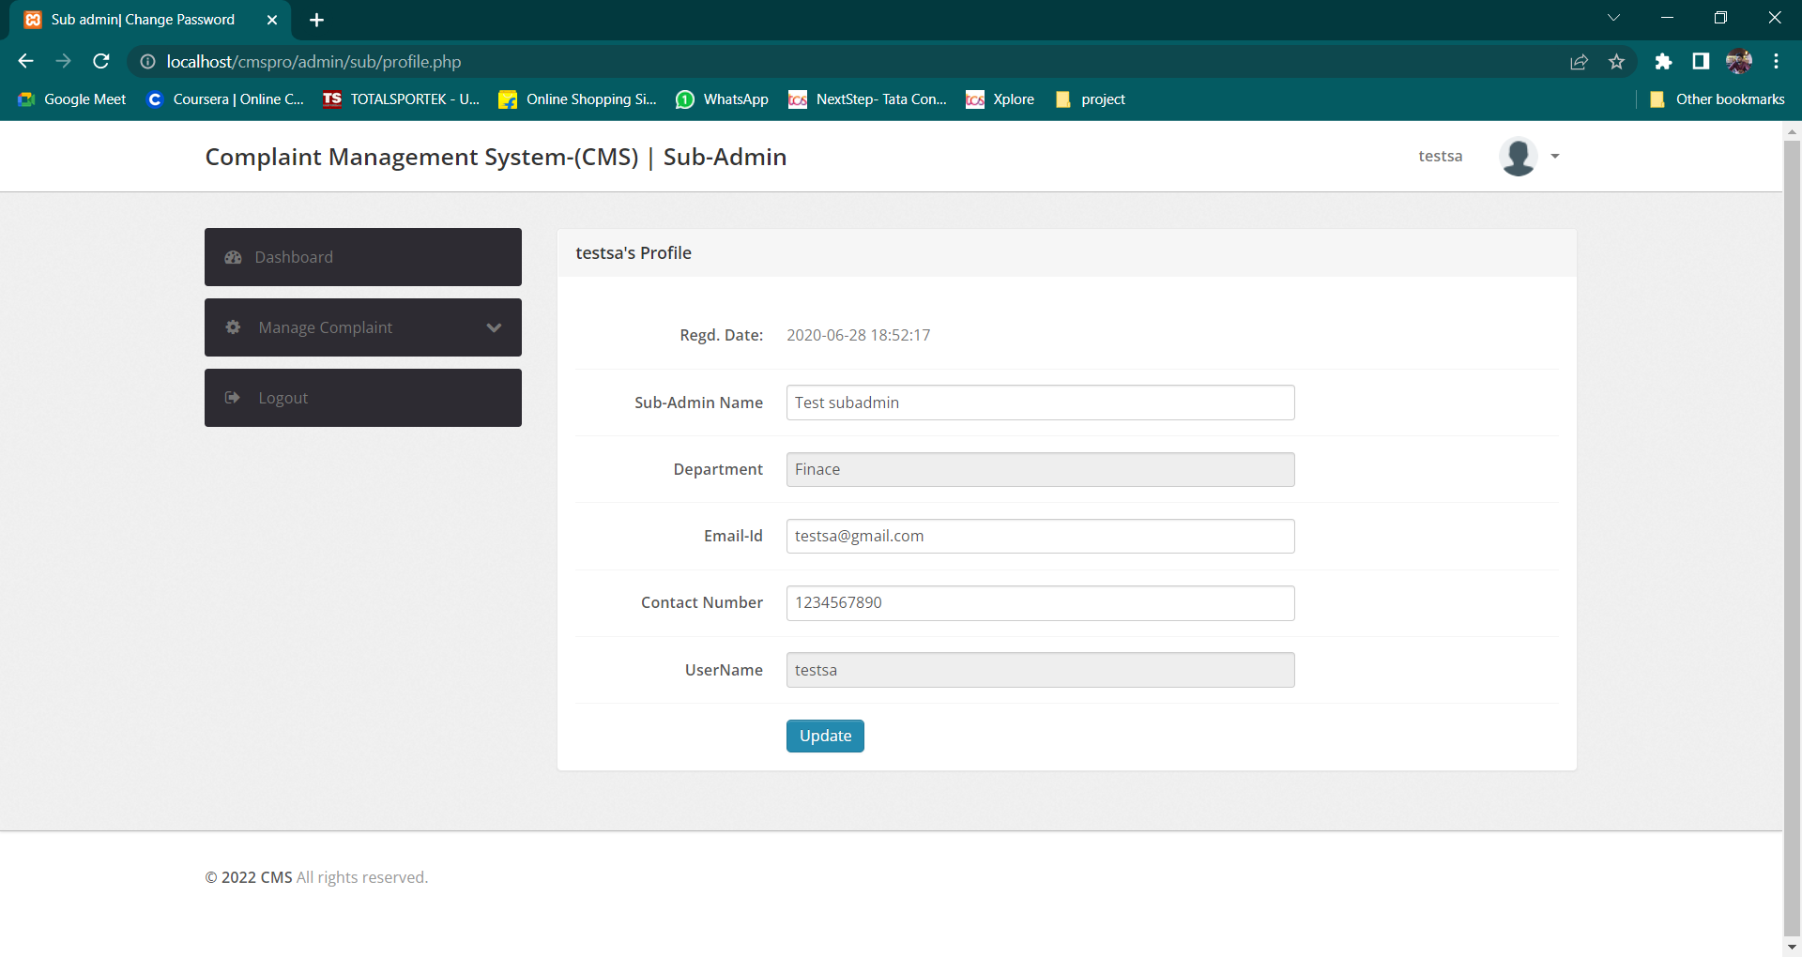

Slide 39
THANK YOU

